Slide 1


Cellula Task 2
Preprocessing Task
Uber Fare Prediction project
Prepared by : Ammar Mohamed

Slide 2

Table of contents
01
Preprocessing Decisions
02
Pipeline & Model
03
Results & Next Steps

Slide 3

01
Preprocessing Decisions
Handling Outliers + Feature Eng + data spliting

Slide 4
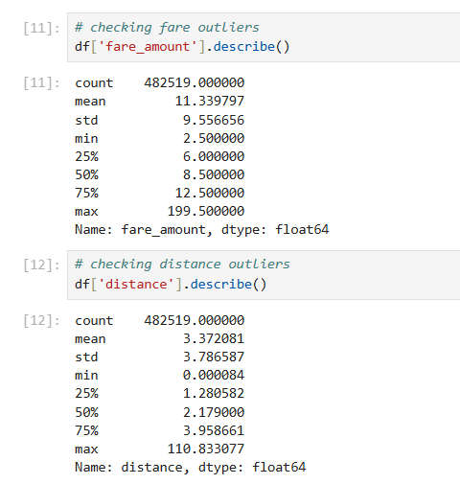
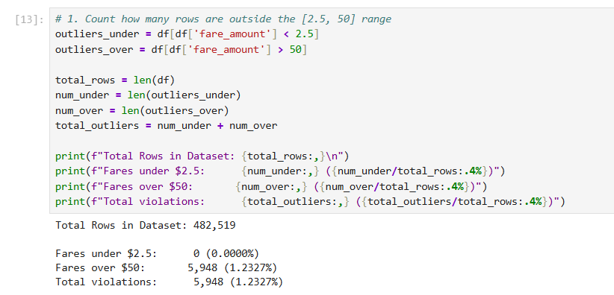

Handling Outliers Manually

Slide 5
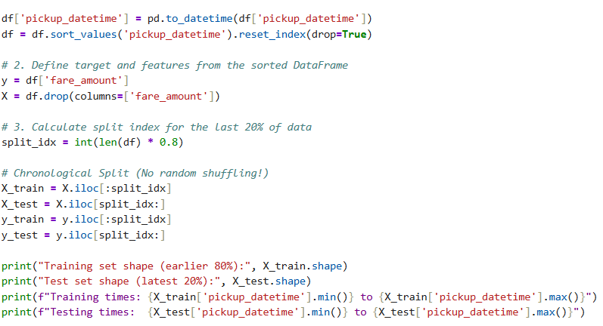
Chronological ordering and split
We used a chronological train-test split to simulate a real-world deployment scenario. The model is trained on historical taxi rides and evaluated on future rides it has never seen before. This reflects how the system would operate in production, where predictions are always made on new incoming data.

Slide 6

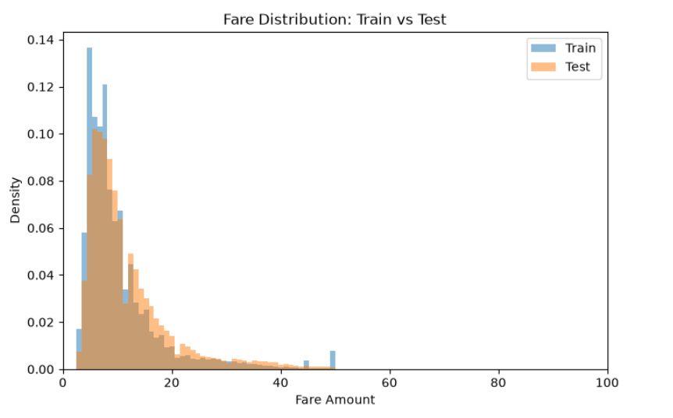
This Chart shows that :
even after spliting according to year we maintian balance between train and test data wrt fair amount which protects our model from overfitting to a specific time period and failing to generalize when predicting fares from a different range of dates.

Slide 7
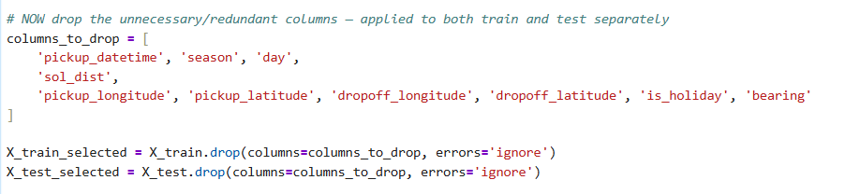
Feature Selection
Dropped Columns :

Slide 8
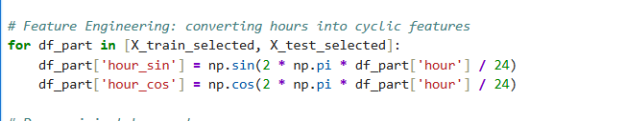
Feature Engineering
Hour was converted from a single 0-23 number into two features (hour_sin, hour_cos) that represent it as a position on a 24-hour circle — this correctly tells the model that 11 PM and midnight are neighbors in time, not opposites.

Slide 9

02
Pipeline & Model
Encoding + Scaling + Tuning
—Someone Famous

Slide 10
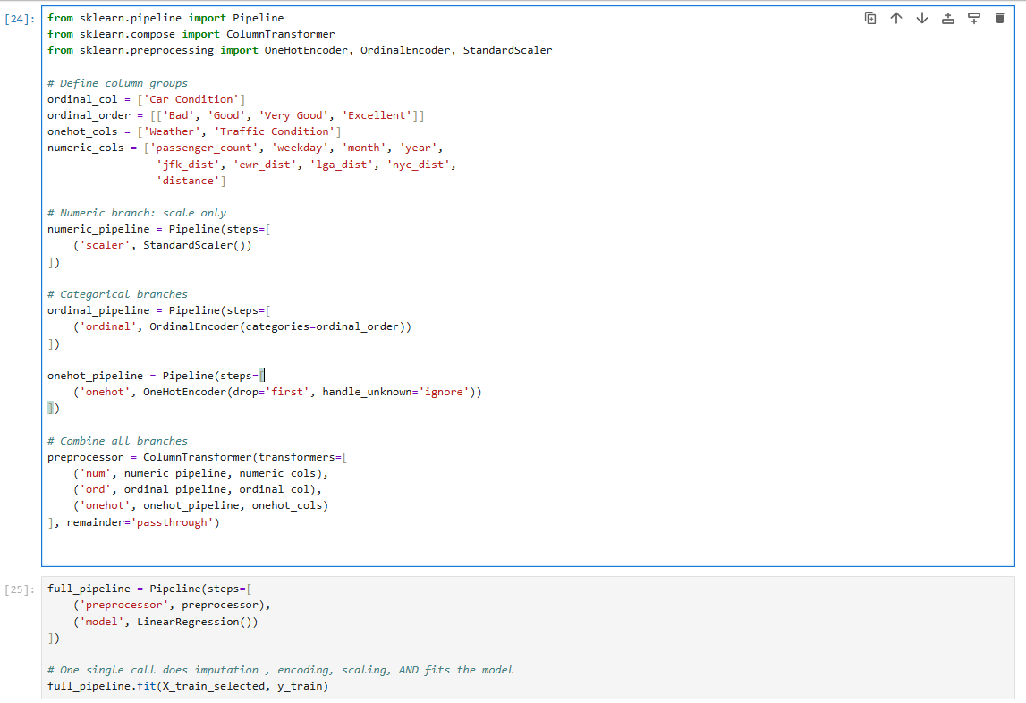
Pipeline Process

Slide 11
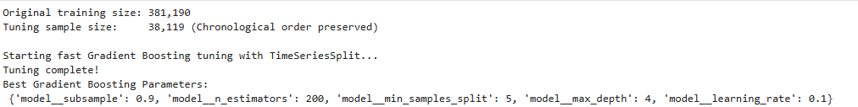
HyperParameter Tuning
Down-sample chronologically — take every 10th row (10% of training data) to speed up tuning, while preserving the full time range from 2009–2014
Time-aware cross-validation — use TimeSeriesSplit (5 folds) instead of random K-Fold, so each fold only trains on data before its validation period, respecting real-world chronology
Build a unified pipeline — bundle preprocessing + Gradient Boosting into a single Pipeline object, ensuring consistent, leak-free transformations at every step
Define the search space — specify candidate values for 5 key hyperparameters (n_estimators, learning_rate, max_depth, min_samples_split, subsample)
Randomized search for best parameters — test 10 random combinations across all 5 time-based folds (50 total fits), scored by MAE, to efficiently find strong hyperparameters without exhaustive search

Slide 12
Model Evaluation
How Do We Judge Model Performance?
We consider three key metrics:
MAE (Mean Absolute Error) – Measures the average prediction error.
RMSE (Root Mean Squared Error) – Penalizes large prediction errors more heavily.
R² Score (Coefficient of Determination) – Measures how well the model explains the variation in the data.
that’s means :
Lower MAE → More accurate predictions.
Lower RMSE → Fewer large prediction errors.
Higher R² → Better ability to explain and predict the target variable.

Slide 13
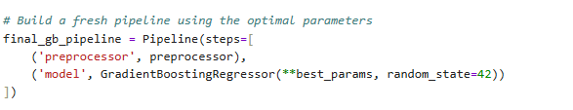

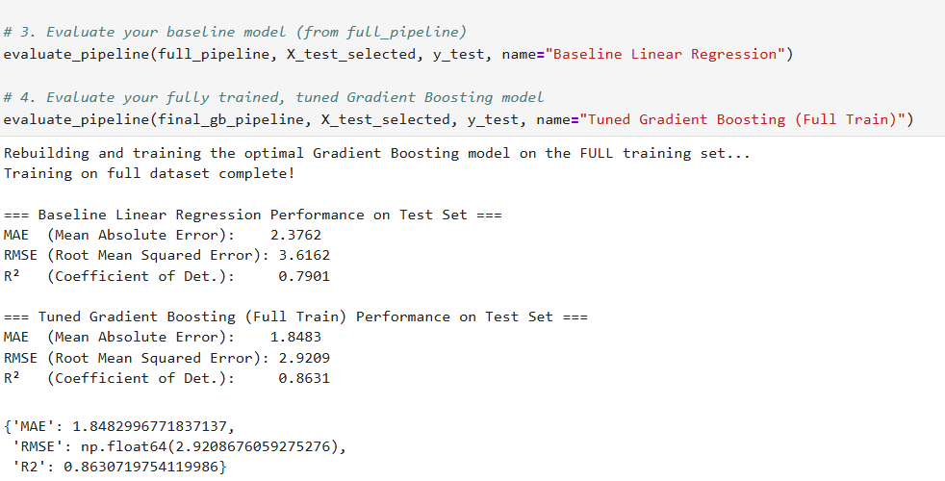
Model Evaluation

Slide 14
Model Evaluation
As we see the model perfromance is 86 which is not bad remember this number well becuase there is a surpise coming in our way
To be honest the first time i run the past cells the effecieny was 75% only
yeah , but with some modification we go up to 86 like:
Handling outliers manaully.
Switching from elastic Net to Gradient boost regressor.
Splitting the data Chronologically .

Slide 15

03
Results & Next Steps
The Optimized Notebook is here

Slide 16
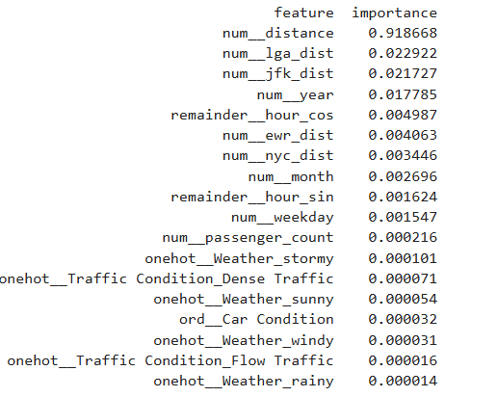
Best Practices and Enhancements
Before leaving the old notebook we asked a very valuable question:
Does ignoring over half our features actually affects accuracy?
This insight will make a big difference in the new optimized notebook we will navigate toghether right now
but we can summarize the differcence between them in :
Pipeline include all the preprocessing .
Outliers are auto checked using Class.
Multicollinearity is auto checked using VIF.
We trained only the most imp features
No need for Encoding

Slide 17

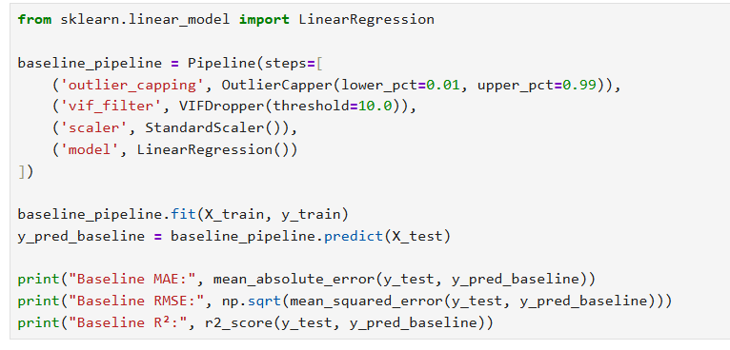

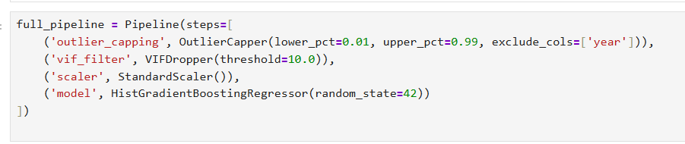

Conclusion

Slide 18



Thanks!
Do you have any questions?
https://github.com/ammar-abdelghany30/uber-data-analysis

